Slide 1
RheoSense microVISC
OPALL
Katie Copenhaver

Slide 2
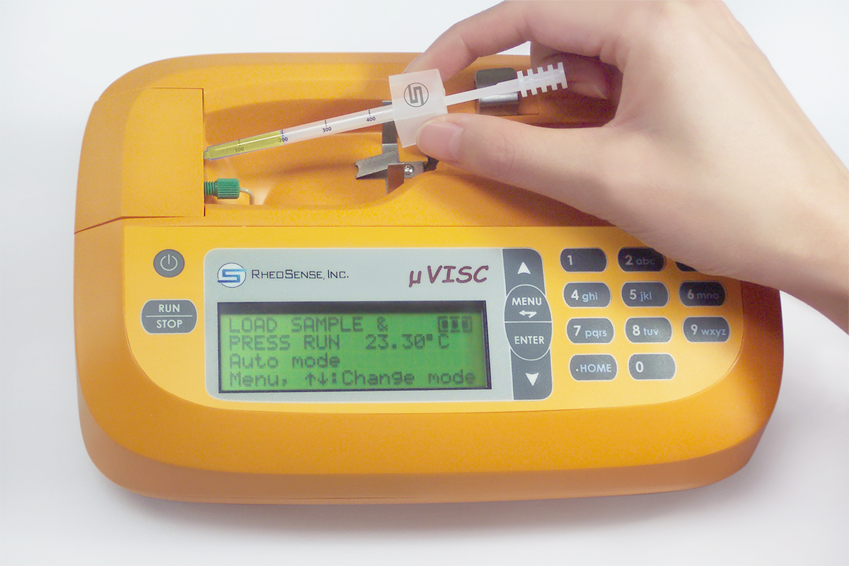
RheoSense microVISC: fast and simple viscosity measurements
RheoSense microVISC can quickly, easily, and accurately determine viscosities of solutions from room temperature to 50° C using only 2-400 μL of material.
Measurements typically take less than one minute, and multiple measurements can be performed using one loaded syringe.

Slide 3
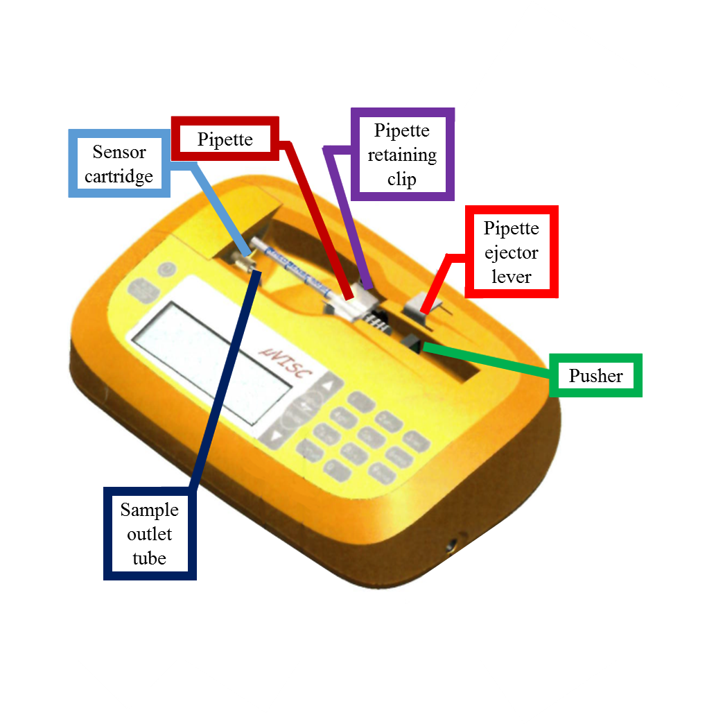
Load pipette and press RUN to operate.
A cleaning cycle using 1% Aquet solution (provided) should be run before and after each set of measurements.
Load samples by drawing liquid up into the pipette, doing your best to minimize bubbles.
Mount the loaded pipette into the unit by guiding the tip into the sample inlet port and pushing down the flange until it clicks into place.
Press RUN/STOP to run in Auto, Advanced, or Cleaning mode.

Slide 4
Auto mode lets the system decide all measurement parameters.
Auto
System will automatically move the pusher to the plunger position, prime the sensor with test fluid, pause for sample relaxation, take a baseline measurement, and measure the viscosity of your sample. The system will try to choose a flow rate such that the pressure reading is 50% of its full scale.

Slide 5
Advanced mode gives the user control over all measurement parameters.
Advanced
The following settings can be specified or left to the machine to automatically decide
Flow rate (μL/min) or shear rate (s⁻¹)
Priming volume
Measurement volume
Relaxation time

Slide 6
Cleaning mode optimizes the flow rates for sensor cleaning.
Cleaning
Cleaning mode should be used when cleaning the sensor with 1% Aquet solution before and after measurements. Cleaning mode will automatically dispense the entire contents of the pipette at 100 μL/min.
If running a polymer solution or colloidal suspension, a cleaning cycle should also be performed after measurements (and before the cleaning cycle with Aquet) using pure solvent.

Slide 7
RheoSense microVISC can be used to measure intrinsic viscosity of polymers.
192k PS in toluene
Measured at 6 concentrations, each measurement repeated 4 times.
η_{sp}/c and ln(η_{rel})/c were extrapolated to c=0, yielding an intrinsic viscosity of 0.7351 ± 0.0096 dL/g
Plot | Slope | Intercept
η_{sp}/c | 0.1614 ± 0.0145 | 0.7462 ± 0.0184
ln(η_{rel})/c | -0.0732 ± 0.0039 | 0.7239 ± 0.0050

Slide 8
Follow these tips for safe and efficient equipment operation.
Wipe the outside of the pipette dry with a lint-free wipe after sample loading to avoid sensor contamination.
After loading the pipette, hold it vertically and push the plunger up slightly to remove bubbles.
Never manually push the plunger after mounting it into the unit.
Load your sample before enabling temperature control, if possible, to cut down on equilibration time.
If your sample is above 100 cP, multiple cleaning cycles may be required.
If your sample contains strong acids or bases, run an extra cleaning cycle with pure water before running the cleaning cycle with Aquet solution.

